Slide 1
ORGANOPHOSPHORUS POISONING (OPP)

Slide 2
ORGANOPHOSPHORUS POISONING
Organophosphates are used world wide
Common cause of poisoning in the developing world

Slide 3
Types of organo phosphate insectisides
Diazinon-phosphorothioic acid
Chlorpyrifos
Malathion
Parathion
Fenthion
Serin

Slide 4
Absorption route;
CUTENEOUSLY
INGESTION (ACCIDENTAL OR SUICIDAL)
INHALATION
INJECTION

Slide 5
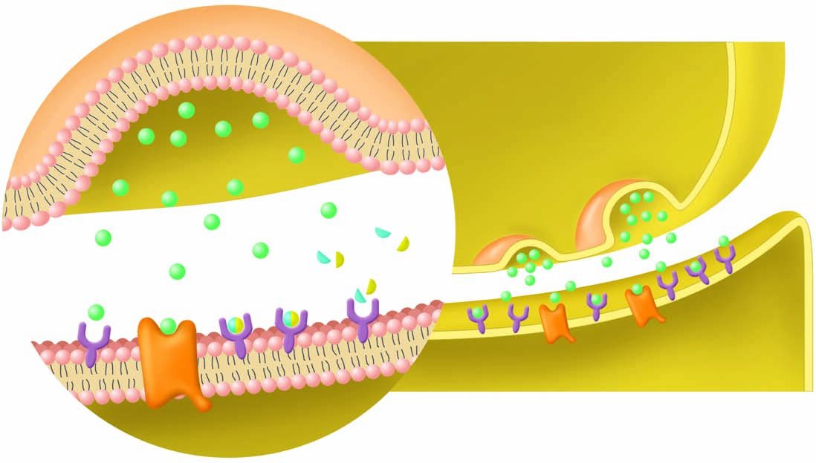
Pathophysiology

Slide 6
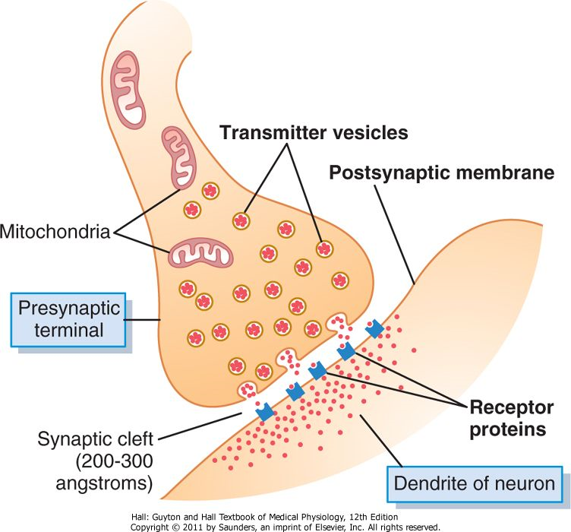

Slide 7
Pathology
Organophosphate are absorbed through the skin, lungs & GI tract and distributed widely in tissues and are slowly eliminated in hepatic metabolism.
Organophosphorus insectisides inhibit acetylcholinesterase, causing accumulation of acetylcholine at central and peripheral cholinergic nerve endings, including neuromuscular junctions.

Slide 8
Clinical Features
History of
      Ingestion
      Inhalation
      Dermal absorption
2. Features of intoxication are delayed i.e. because it requires biotransformation to become active

Slide 9
3.Muscarinic effects of Poisoning are characterized by;
  Anxiety
  Restless
  Tiredness
  Vomiting
  Abdominal colic cramps
  Diarrhea
  Tenesmus
  Sweating
  Rhinorrhoea
Bronchorrhoea - dyspnoea due to bronchoconstriction
Chest tightness
Nausea
Urinary and fecal incontinence
Lacrimation
Miosis (constriction of the pupil)
Wheeze

Slide 10
4. Nicotinic effects
Muscle fasciculation
Flaccid paralysis
      Limbs muscles
      Respiratory muscles
      Extra ocular muscles
Weakness
Fatigue

Slide 11
5. Respiratory system
Respiratory failure – worsened/exacerbated by development of rhinorrhoea and pulmonary Oedema.
6. CNS – occur in severe poisoning
        Coma
        Convulsions
        Headache
        Loss of memory
9. Organophosphate induced neuropathy
Starts two weeks or more after exposure
Occurs due to degeneration of
mylenated motor & sensory fibres

Slide 12
DIAGNOSIS
Erythrocyte cholinesterase activity.
Plasma cholinesterase is less specific i.e. it may be depressed.
Others
CXR - EVALUATE PULMONARY OEDEMA
ECG - CARDIAC ARRYTHMIAS ELECTROLYTES

Slide 13
Treatment
Mild
No specific treatment
Clearing the Airway,
Adequate ventilation - consider oxygenation
Remove soiled clothes
Wash contaminated skin to prevent further absorption.

Slide 14
2. Patients with systemic features
i) IV atropine 1- 3 mgs every 5-10 minutes till signs of atropinization are seen (DRY SKIN, DILATED PUPILS)
MOA
Reduces - Bronchorrhoea & Rhinorrhoea
It is a beta adrenoceptor blocking drug.
ii) Add an OXIME e.g. Pralidoxime
  Dose – Slow IV injection 30mg/kg every 4-6 hours
- or infusion 8-10mg/kg/h
  MOA
  -Reactivates phophorylated acetyl cholinesterase.
iii) Gastric lavage within an hour followed by activated
Charcoal administered via nasogastric tube
iv) Wash the patient – to prevent dermal absorption
v) Wash soiled clothes

Slide 15
Adequate oxygenation – To minimize dysrhythmias
Lasix
Antacids
IVF – Normal saline
Monitor patient 2 hourly in left lateral position
Consider ICU care if in coma unconscious
Counselling

Slide 16
NOTE
Oxygen therapy is recommended to be given before atropine therapy.
Record pulse rate, blood pressure, pupil size, presence of sweat, and auscultatory findings at time of first atropine dose.
5 min after giving atropine, check pulse, blood pressure, pupil size, sweat, and chest sounds. If no improvement has taken place, give double the original dose of atropine.

Slide 17
3. Continue to review every 5 min; give doubling doses of atropine if response is still absent. Once parameters have begun to improve, cease dose doubling. Similar or smaller doses can be used.
4. Atropine therapy should be monitored to maintain systolic blood pressure > 80 mmHg, pulse > 80 beats/min and clear chest on auscultation.

Slide 18
THE END

